Slide 1
Applied Machine learning
Regent College London
SWE6302

Slide 2
Applied Machine learning
SWE6302

Slide 3

Applied Machine learning
REGRESSION METHODS

Slide 4
Module – LINEAR REGRESSION, Multiple Regression & Polynomial Regression

Slide 5
Learning objectives
Understand the Linear Regression
Understand the the Linear Regression Loss
Understand R-Squared Error
Linear Regression Python example
Define Multiple Regression
Real life applications of Multiple Regression
Practical implementation of Multiple Regression
Understand concept of Polynomial Regression
Understand the Overfitting and Underfitting
Understand techniques to overcome Overfitting

Slide 6
Review
Previously, we have explored deployment of Machine Learning models and the current state-of-the-art Machine Learning that includes Deep Learning.
However, before we get in details on how modern machine learning techniques like Deep Learning works, we need to understand some of the fundamental models of traditional machine learning such as regression.
Today’s topic will include the fundamentals of regression models specifically linear regression and multiple regression.

Slide 7
REGRESSION
Regression is a method of modeling a target value based on independent predictors
It is a statistical tool which is used to find out the relationship between the outcome variable also known as the dependent variable, and one or more variable often called as independent variables
This method is mostly used for forecasting and finding out cause-and-effect relationships between variables
Regression techniques mostly differ based on the number of independent variables and the type of relationship between the independent and dependent variables.
Notes:
https://www.mygreatlearning.com/blog/linear-regression-in-machine-learning/
Regression method tries to find the best fit line which shows the relationship between the dependent variable and predictors with least error.
In regression, the output/dependent variable is the function of an independent variable and the coefficient and the error term.

Slide 8
REGRESSION
Regression method tries to find the best fit line which shows the relationship between the dependent variable and predictors with least error.
In regression, the output/dependent variable is the function of an independent variable and the coefficient and the error term.
Linear Regression is the basic form of regression analysis. It assumes that there is a linear relationship between the dependent variable and the predictor(s).

Slide 9
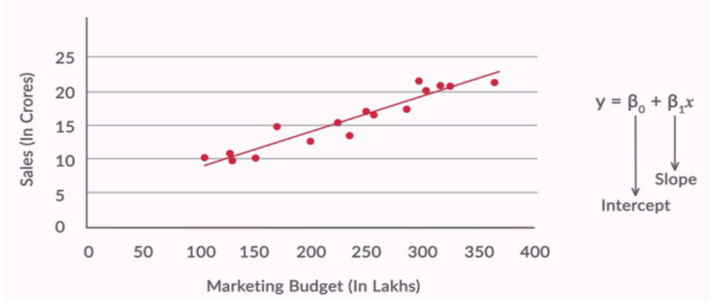

REGRESSION
Through the best fit line, we can describe the impact of change in independent variables on the dependent variable.

Slide 10
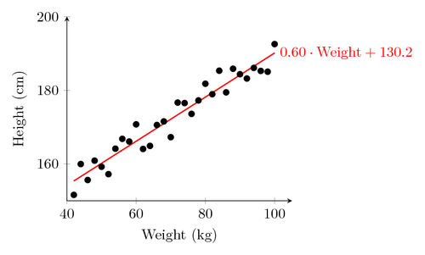
REGRESSION
Fit a line to a data set of observations
Use this line to predict unobserved values

Slide 11
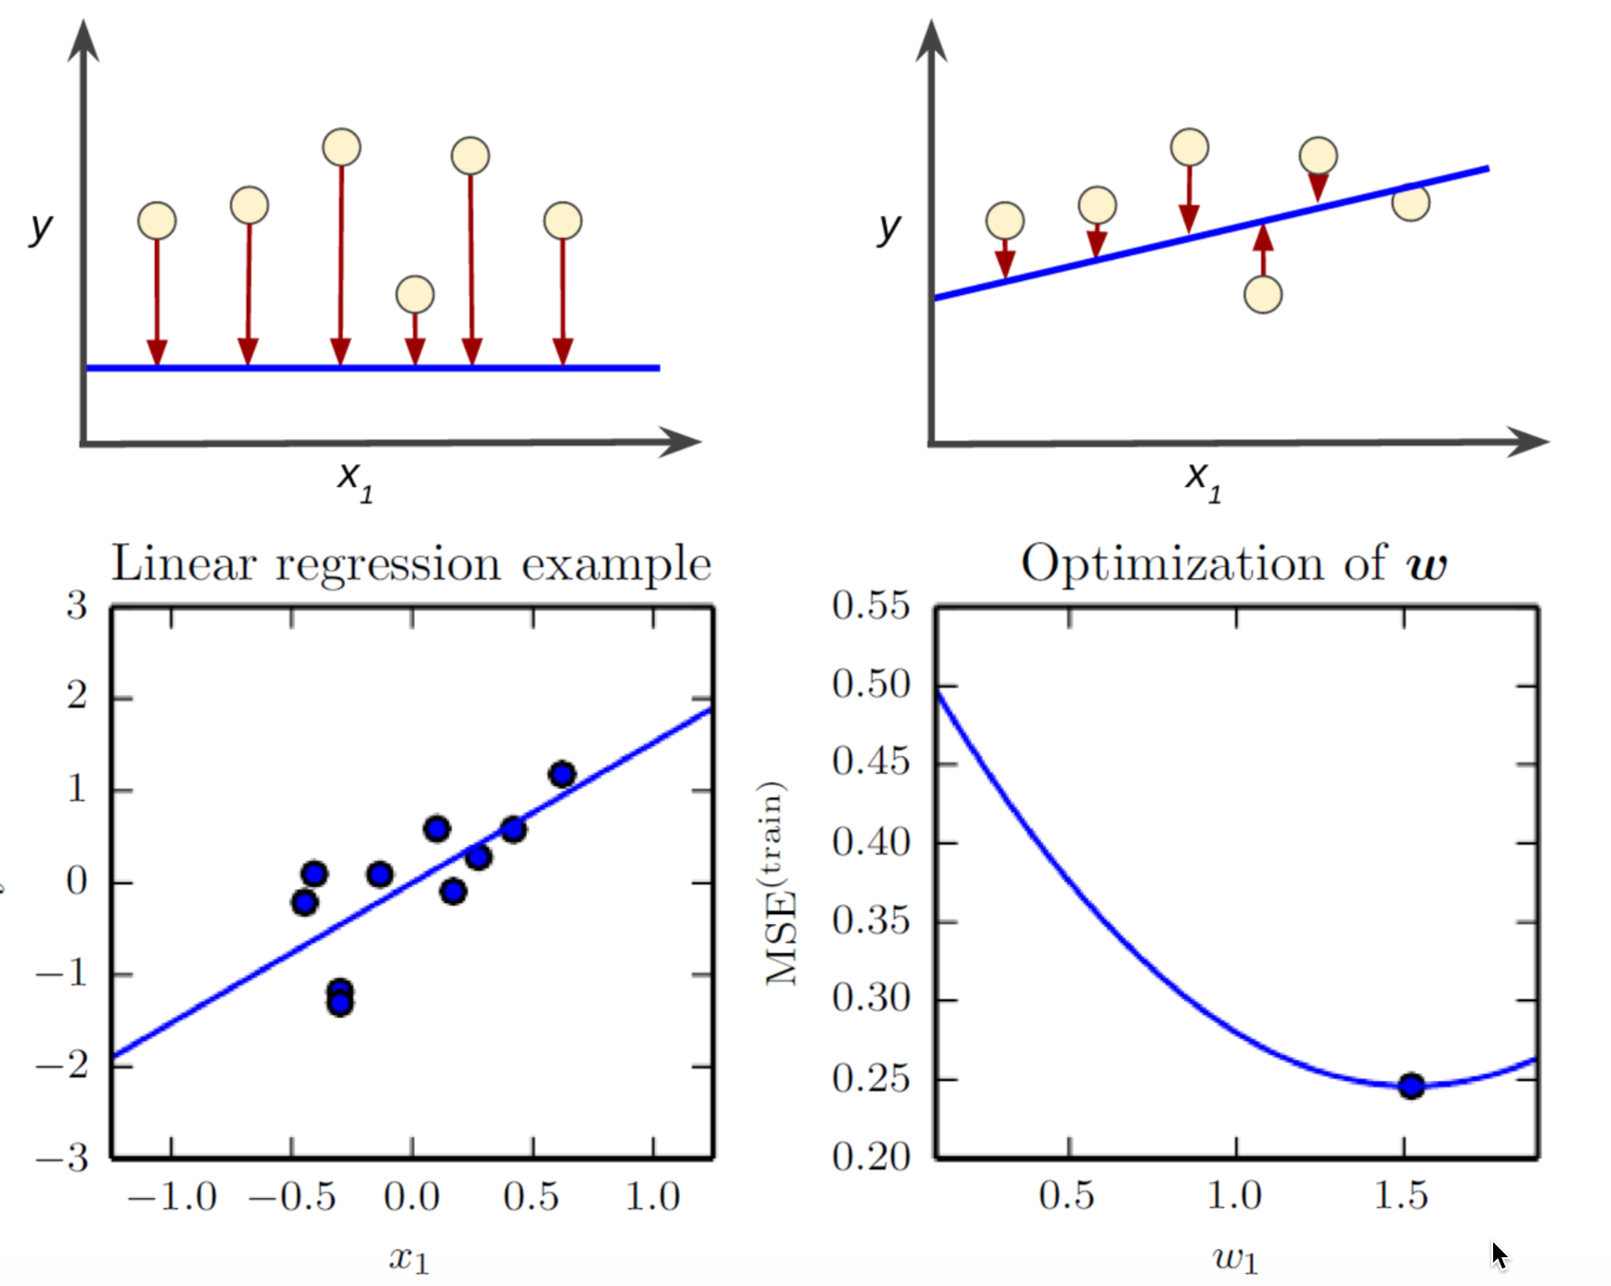
Minimise the loss

Slide 12
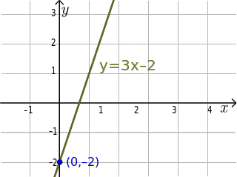
Linear regression technique i
Usually using “least squares”
Minimizes the squared-error between each point and the line
Remember the slope-intercept equation of a line? y=mx+b
The slope is the correlation between the two variables times the standard deviation in Y, all divided by the standard deviation in X.

Slide 13
Linear regression technique ii
Neat how standard deviation how some real mathematical meaning, eh?
The intercept is the mean of Y minus the slope times the mean of X
But Python will do all that for you.

Slide 14
How does it work
Least squares minimizes the sum of squared errors.
This is the same as maximizing the likelihood of the observed data if you start thinking of the problem in terms of probabilities and probability distribution functions
This is sometimes called “maximum likelihood estimation”

Slide 15
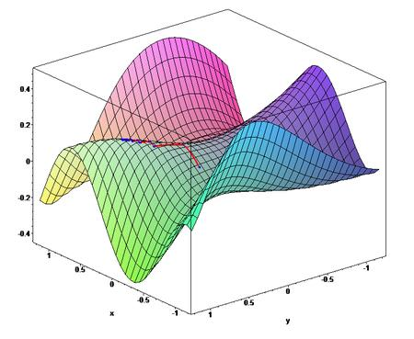
optimiser
Gradient Descent is an alternate method to least squares.
Basically, iterates to find the line that best follows the contours defined by the data.
Can make sense when dealing with 3D data
Easy to try in Python and just compare the results to least squares
But usually, least squares is a perfectly good choice.

Slide 16
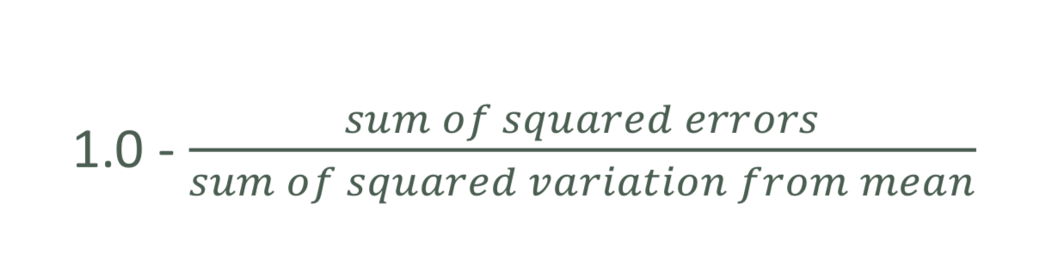
Measurement error with r-squared
How do we measure how well our line fits our data?
R-squared (aka coefficient of determination) measures:
The fraction of the total variation in Y that is captured by the model

Slide 17
Let’s play with an example.

Slide 18
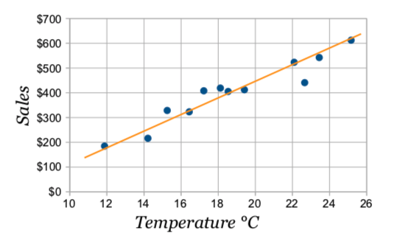
Least square regression-example
Line of Best Fit
Imagine you have some points, and want to have a line that best fits them like this:
Notes:
We can place the line "by eye": try to have the line as close as possible to all points, and a similar number of points above and below the line.

Slide 19
The line
Our aim is to calculate the values m (slope) and b (y-intercept) in the equation of a line : y = mx + b
Where:
y = how far up
x = how far along
m = Slope or Gradient (how steep the line is)
b = the Y Intercept (where the line crosses the Y axis)

Slide 20
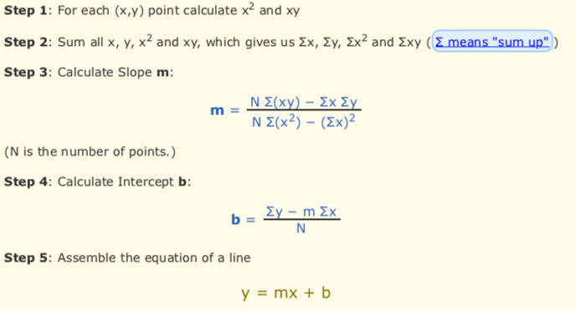
steps

Slide 21
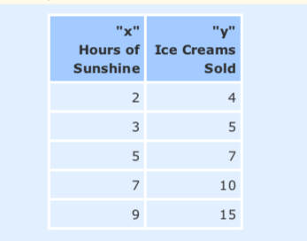
activity
Example: Sam found how many hours of sunshine vs how many ice creams were sold at the shop from Monday to Friday
Calculate Linear regression line using above equation

Slide 22
Recap (Summary)
Linear regression: Determine association between a dependent variable and a series of other independent variables.
Results in a models to make predictions, such as predicting a company's stock price.
Showing the data in a scatter plot is ideal for determining the strength of the relationship between explanatory (independent) and dependent variables.
Increasing or decreasing trends after applying a linear regression model are observed for making a decision on applying linear model for prediction
Correlation coefficients are used to calculate how strong a relationship is between two variables.
Denoted by r and has a value between -1 and 1.
Notes:
What Is Linear Regression? How It's Used in Machine Learning
July 16, 2021
by Amal Joby

Slide 23
examples
Relationship between study time and grades, you’d probably see a positive relationship.
Relationship between time on social media and grades, you'll most likely see a negative relationship.
“grades” : dependent variable
time spent studying or on social media:independent variable.
grades depend t on how much time you spend studying.
A linear regression line is a line which is a straight line.
Notes:
What Is Linear Regression? How It's Used in Machine Learning (g2.com)

Slide 24
Simple linear equation
y is the estimated dependant variable (or the output)
m is the regression coefficient (or the slope)
x is the independent variable (or the input)
c is the constant (or the y-intercept)
Finding the relationship between variables makes it possible to predict values or outcomes. In other words, linear regression makes it possible to predict new values based on existing data.
Y=mx+c

Slide 25
Key terminologies in linear regression
Variable: number, quantity, or characteristic that can be counted or measured, also called a data item. Income, age, speed, and gender etc.
Coefficient: It's a number (usually an integer) multiplied with the variable next to it. For instance, in 7x, the number 7 is the coefficient.
Outliers: Data points significantly different from the rest. For example, imagine placing this data set in ascending order: 3, 6, 7, 10, and 54. 54 might be an outlier because it is significantly higher than the other data points.
Covariance: The direction of the linear relationship between two variables. In other words, it calculates the degree to which two variables are linearly related.
Notes:
No noise: eg. that there are no outliers in the data
No collinearity: if you have highly correlated predictors, it’s most likely your model will overfit
Linearity: assumes that the relationship between predictors and target variable is linear

Slide 26
Key terminologies in linear regression
Multivariate: two or more dependent variables resulting in a single outcome.
Residuals: The difference between the observed and predicted values of the dependent variable.
Variability: The lack of consistency or the extent to which a distribution is squeezed or stretched.
Linearity: relationship that is closely related to proportionality and can be represented as a straight line.
Collinearity: Correlation between the independent variables, such that they exhibit a linear relationship in a regression model.
Standard deviation (SD): It's a measure of the dispersion of a dataset relative to its mean or measure of how spread out numbers are. Standard deviation calculation:
https://www.youtube.com/watch?v=IaTFpp-uzp0
Notes:
No noise: eg. that there are no outliers in the data
No collinearity: if you have highly correlated predictors, it’s most likely your model will overfit
Linearity: assumes that the relationship between predictors and target variable is linear

Slide 27
Techniques to solve linear regression
Simple linear regression
Single input or one independent variable and one dependent variable to find the best relationship between two variables, given that they're in continuous nature.
For example, it can be used to predict the amount of weight gained based on the calories consumed.
Ordinary least squares
Another method to estimate the value of coefficients when there is more than one independent variable or input. It's one of the most common approaches for solving linear regression and is also known as a normal equation.
This procedure tries to minimize the sum of the squared residuals.
Gradient descent
One of the easiest and commonly used methods to solve linear regression problems.
Useful when there are one or more inputs and involves optimizing the value of coefficients by minimizing the model's error iteratively.

Slide 28
Multiple Regression

Slide 29
Regression Models
Simple linear regression is a regression model that estimates the relationship between a dependent variable and an independent variable using a straight line.
Multiple linear regression estimates the relationship between two or more independent variables and one dependent variable.
In the real world, there are an ample number of situations where many independent variables get influenced by other variables for that we have to look for other options rather than a single regression model that can only work with one independent variable.

Slide 30

Multiple regression
What if more than one variable influences the one, you’re interested in?
Example: predicting a price for a car based on its many attributes (body style, brand, mileage, etc.)

Slide 31
Examples of multiple regression in real life
Multiple regression tries to find out a formula that can explain how factors in variables respond simultaneously to changes in others.
MR John wants to estimate the price of a house. He will collect details such as the location of the house, number of bedrooms, size in square feet, amenities available, or not. Basis these details price of the house can be predicted and how each variables are interrelated.
An agriculture scientist wants to predict the total crop yield expected for the summer. He collected details of the expected amount of rainfall, fertilizers to be used, and soil conditions. By building a Multivariate regression model scientists can predict his crop yield. With the crop yield, the scientist also tries to understand the relationship among the variables.
If an organization wants to know how much it has to pay to a new hire, they will take into account many details such as education level, number of experience, job location, has niche skill or not. Basis this information salary of an employee can be predicted, how these variables help in estimating the salary.
Economists use to predict the GDP growth of a state or a country based on parameters like total amount spent by consumers, import expenditure, total gains from exports, total savings, etc.
A company wants to predict the electricity bill of an apartment, the details needed here are the number of flats, the number of appliances in usage, the number of people at home, etc. With the help of these variables, the electricity bill can be predicted.
Notes:
mygreatlearning.2022.Introduction to Multivariate Regression Analysis.[].https://www.mygreatlearning.com/blog/introduction-to-multivariate-regression/

Slide 32
Still uses least square
We just end up with coefficients for each factor.
For example, 𝑝𝑟𝑖𝑐𝑒 = 𝛼 + 𝛽1 mileage + 𝛽2age + 𝛽3doors …123
These coefficients imply how important each factor is
Get rid of ones that don’t matter!
Can still measure fit with r-squared
Need to assume the different factors are not themselves dependent on each other.

Slide 33
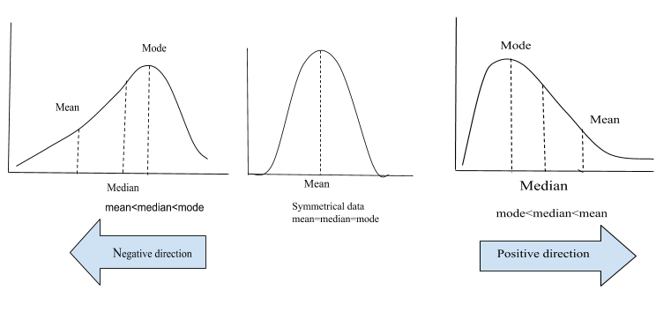
Normality ?
Linear Regression and many other models assume that the data is normally distributed. If this assumption fails the model fails to give accurate predictions.
A probability distribution with the mean 0 and standard deviation of 1 is known as standard normal distribution or Gaussian distribution.
A normal distibution is symmetric about the mean and follows a bell shaped curve . And almost 99.7% of the values lies within 3 standard deviation. The mean, median and mode of a normal distribution are equal.

Slide 34
Normality ?
SKEWNESS
Skewness of a distribution is defined as the lack of symmetry. In a symmetrical distribution, the Mean, Meadian and Mode are equal.The normal distribution has a skewness of 0. Skewness tell us about distribution of our data.
Skewness is of two types:
Positive skewness: When the tail on the right side of the distribution is longer or fatter, we say the data is positively skewed. For a positive skewness mean > median > mode.
Negative skewness: When the tail on the left side of the distribution is longer or fatter, we say that the distribution is negatively skewed. For a negative skewness mean < median < mode.
What does skewness tells us? Consider house prices ranging from 100k to 1,000,000 with the average being 500,000.
If the peak of the distribution is in left side that means our data is positively skewed and most of the houses are being sold at the price less than the average.
If the peak of the distribution is in right side that means our data is negatively skewed and most of the houses are being sold at the price greater than the average.
Now, the question is when we can say our data is moderately skewed or heavily skewed.
The thumb rule is: If the skewness is between -0.5 to +0.5 then we can say data is fairly symmetrical. If the skewness is between -1 to -0.5 or 0.5 to 1 then data is moderately skewed. And if the skewness is less than -1 and greater than +1 then our data is heavily skewed.

Slide 35
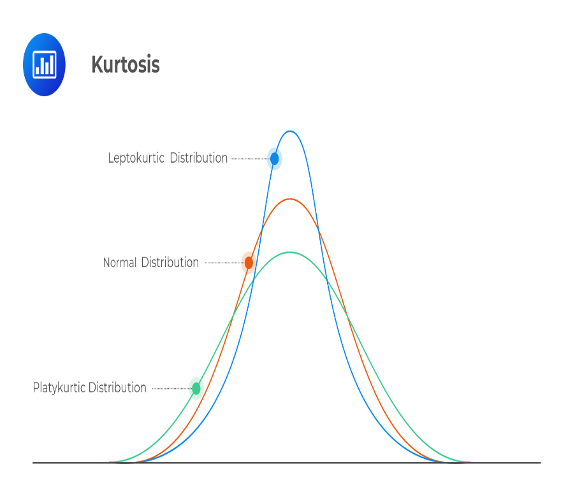
kurtosis
About the shape or peakedness or flatness of the distribution but this is not correct.
Kurtosis tell us about the tails behaviour. It is actually the measure of outliers present in the distribution.
Kurtosis are of three types:
Mesokurtic: When the tails of the distibution is similar to the normal distribution then it is mesokurtic. The kutosis for normal distibution is 3.
Leptokurtic: If the kurtosis is greater than 3 then it is leptokurtic. In this case, the tails will be heavier than the normal distribution which means lots of outliers are present in the data. It can be recognized as thin bell shaped distribution with a peak higher than normal distribution.
Platykurtic: Kurtosis will be less than 3 which implies thinner tail or lack of outliers than normal distribution. In case of platykurtic, bell shaped distribution will be broader and peak will be lower than the mesokurtic.
Notes:
Skewness-and-kurtosis/SKEWNESS_AND_KURTOSIS_(1).ipynb at master · manvendra7/Skewness-and-kurtosis · GitHub

Slide 36
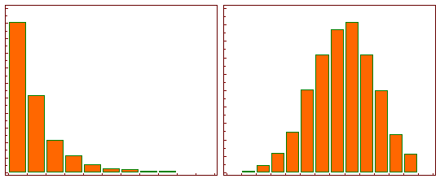
Log tranformation
When our original continuous data do not follow the bell curve, we can log transform this data to make it as “normal” as possible so that the statistical analysis results from this data become more valid. In other words, the log transformation reduces or removes the skewness of our original data. import numpy as np
x = [1, 2, 3, 4, 5]
y = np.log(x)
y
Notes:
Htton,S,K.2020.https://medium.com/@kyawsawhtoon/log-transformation-purpose-and-interpretation-9444b4b049c9

Slide 37

Cost function
Using a multivariate model helps us compare coefficients across outcomes. What makes a multivariate or multiple linear regression a better model is a small cost function.
Cost Function
In simple words it is a function that assigns a cost to instances where the model deviates from the observed data. In this case, our cost is the sum of squared errors. The cost function for multiple linear regression is given by:
We can understand this equation as the summation of square of difference between our predicted value and the actual value divided by twice of length of data set. A smaller mean squared error implies a better performance. Generally, a cost function is used along with the Gradient Descent algorithm to find the best parameters.

Slide 38
Steps in machine learning
STEP 1: Explore the DATA
STEP 2: VISUALISING THE DATA
STEP 3: FEATURE ENGINEERING
STEP 4: FITTING THE MODEL
STEP 5: Prediction

Slide 39
Video -visual
Watch the you tube video on Multiple regression
https://www.youtube.com/watch?v=zITIFTsivN8 (6 minutes)

Slide 40
Polynomial Regression

Slide 41
Polynomial introduction
When we have a dataset with one predictor variable and one response variable, we often use simple linear regression to quantify the relationship between the two variables.
However, simple linear regression (SLR) assumes that the relationship between the predictor and response variable is linear. But in practice the relationship between the two variables can actually be nonlinear and attempting to use linear regression can result in a poorly fit model.
One way to account for a nonlinear relationship between the predictor and response variable is to use polynomial regression, which takes the form:
Y = β₀ + β₁X + β₂X² + … + β_{h}X^{h} + ε
In this equation, h is referred to as the degree of the polynomial.
Notes:
POSTED ON NOVEMBER 18, 2020 BY ZACH
An Introduction to Polynomial Regression

Slide 42
Polynomial regression
https://www.youtube.com/watch?v=QptI-vDle8Y
https://serokell.io/blog/polynomial-regression-analysis

Slide 43
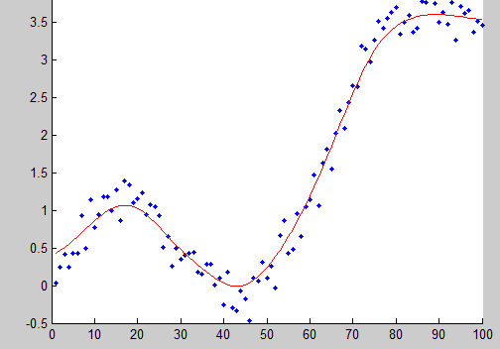
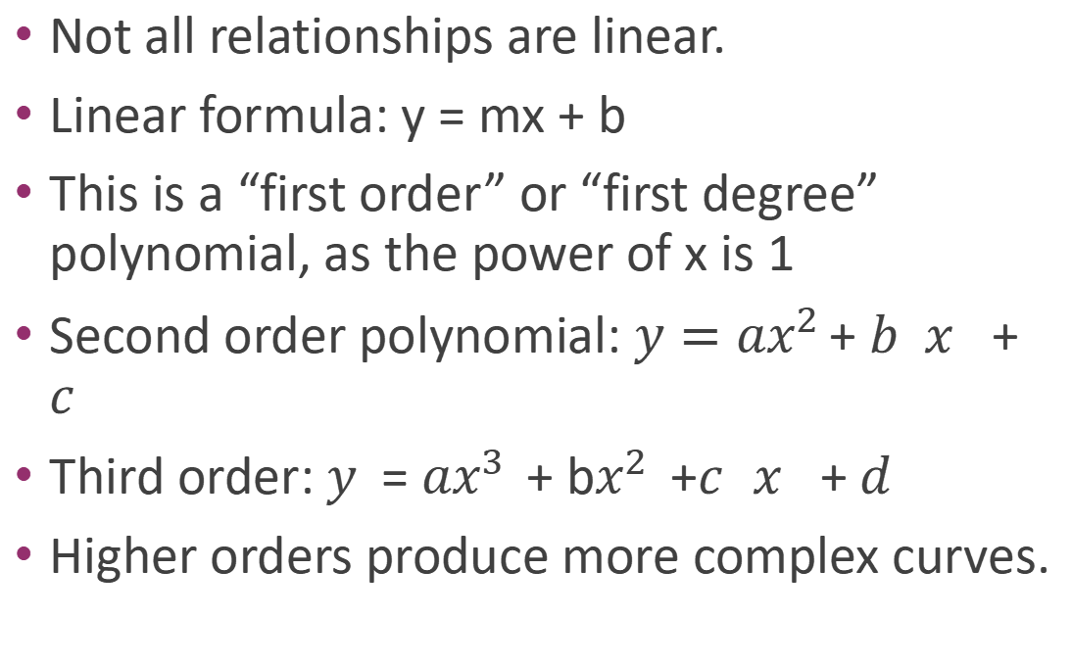
Why limit ourself to straight line
Not all relationships are linear.
Linear formula: y = mx + b
This is a “first order” or “first degree” polynomial, as the power of x is 1
Second order polynomial: $y=ax^{2 }$+ 𝑏𝑥 + 𝑐
Third order: 𝑦= $ax^{3 }$+ b$x^{2 }$ +𝑐𝑥 + 𝑑
Higher orders produce more complex curves.

Slide 44
Polynomial introduction
The model is trained using Polynomial regression and leads to minimum error as well the model accuracy on the training data is 90%.
Then you trained the model using Linear Regression and you observed that it has more errors than what was seen in the Polynomial Regression. So you decide to use the Polynomial regression, but this does not solve the problem. The problem is that when it works on the unseen data, the results are not accurate.
How does it behave in the future when used on different data?

Slide 45
overfitting
In polynomial regression, you can choose different degrees and every degree will give a different curve, also as you increase the degrees, the curve wants to touch all the data that it sees during training and this results in overfitting.
This will lead to less errors on training data , but it will fail on the test data or the future data when the model is used. The models knows the training data does not generalize on the future data.
Poly means many , Nomial means terms or parts
If the 2x+5: It is a simple mathematical equation of two parts:
2x and 5 Or 5 square 2 -2x+5 will be a straight line
Is a polynomial of 3 terms
Ax+b is a linear polynomial

Slide 46
Beware of overfitting
Don’t use more degrees than you need
Visualize your data first to see how complex of a curve there might really be
Visualize the fit – is your curve going out of its way to accommodate outliers?
A high r-squared simply means your curve fits your training data well; but it may not be a good predictor.
Later we’ll talk about more principled ways to detect overfitting (train/test)

Slide 47
Overfitting and underfitting
https://www.youtube.com/watch?v=W-0-u6XVbE4

Slide 48
Ways to prevent the overfitting
https://www.javatpoint.com/overfitting-in-machine-learning

Slide 49
Python coding
• numpy.polyfit() makes it easy.

Slide 50
Poly1d
A one-dimensional polynomial class.
The numpy.poly1d() function helps to define a polynomial function. It makes it easy to apply “natural operations” on polynomials.
#NumPy has a method that lets us make a polynomial model:
mymodel = numpy.poly1d(numpy.polyfit(x, y, 3))
myline = numpy.linspace(1, 22, 100)
#start, end and no of points
print(r2_score(y, mymodel(x)))
predictedvalue = mymodel(17)

Slide 51
Advantages of polynomial regression and uses
You can model non-linear relationship between variables.
Tissue growth rate predictions: to consider the non-linear character of the spreading.
Speed regulation software: Allows you to search for patterns in the driver behaviour and inform about the necessity to adhere to the rules even before speed limits are overtaken. Preventive measures have been reported which are effective in decreasing the number of incidents on the roads.
Notes:
Introduction to Polynomial Regression Analysis
Yulia Gavrilova
Article by Yulia Gavrilova
September 21st, 2021
https://serokell.io/blog/polynomial-regression-analysis

Slide 52
Train-Test Split
Train-test split is used to estimate the performance of machine learning algorithms when these are used to make predictions on the data which has not been used to train the model.
It is an evaluation procedure
It is appropriate when there is a large dataset and can be used for classification or regression problems.
scikit-learn machine learning library is used to perform the train-test split procedure
It is not suitable for small datasets as there will not be enough data in the test set to effectively evaluate the model performance.
For small datasets k-fold cross-validation procedure will be efficient.
Notes:
Train-Test Split for Evaluating Machine Learning Algorithms
by Jason Brownlee on July 24, 2020 in Python Machine Learning

Slide 53
Train-Test Split
The dataset is divided into two subsets.
First subset is used to fit the model –Training Dataset
Second dataset is used to pass to the model and predictions are made and compared to the expected values-Test Dataset (Evaluation Dataset)
Training dataset is typically larger than the testing dataset. Once data from our datasets are fed to a machine learning algorithm, it learns patterns from the data and makes decisions.
Test data provides a final, real-world check of an unseen dataset to confirm that the machine learning algorithm was trained effectively.
The difference between training data vs. test data is clear: one trains a model, the other confirms it works (or doesn’t work) correctly with previously unseen data.
Common split percentages include:
Train : 80%, Test 20%
Train : 67%, Test 33%
Train : 50%, Test 50%
Notes:
https://www.obviously.ai/post/the-difference-between-training-data-vs-test-data-in-machine-learning

Slide 54
Syntax of splitting
train,test=train_test_split(dataset,….)
X_train,X_test, y_train,y_test =train_test_split(dataset or X,y,,….test_size=)
When random_state is set and split again, and we should see the same split
X_train, X_test, y_train, y_test = train_test_split(X, y, test_size=0.33, random_state=1)
Notes:
When comparing machine learning algorithms, it is desirable (perhaps required) that they are fit and evaluated on the same subsets of the dataset.

Slide 55
Scaling-standardization
The standardization method uses this formula:
Z(new value) = (x(original value) – u(mean)) / s (standard deviation)
(790 - 1292.23) / 238.74 = -2.1
Python sklearn module has a method called StandardScaler() which returns a Scaler object with methods for transforming data sets.
from sklearn.preprocessing import StandardScaler
scale = StandardScaler()
X = df[['Weight', 'Volume']]
scaledX = scale.fit_transform(X)
Car | Model | Volume | Weight | CO2
Toyota | Aygo | 1.0 | 790 | 99
Mitsubishi | Space Star | 1.2 | 1160 | 95
Skoda | Citigo | 1.0 | 929 | 95

Slide 56
visual
Introduction to Polynomial Regression Analysis (serokell.io)
To watch the video on polynomial regression

Slide 57
summary
In this session, the following concepts were discussed:
Polynomial regression
Advantages and issues like overfitting
Scaling the data and evaluating the model using train-test

Slide 58
REFERENCE
https://towardsdatascience.com/laymans-introduction-to-linear-regression-8b334a3dab09#:~:text=Linear%20regression%20attempts%20to%20model,variable%20(e.g.%20your%20expenses).
https://www.mygreatlearning.com/blog/linear-regression-in-machine-learning/
https://www.youtube.com/watch?v=JvS2triCgOY
mygreatlearning.2022.Introduction to Multivariate Regression Analysis.[Online].Available at: https://www.mygreatlearning.com/blog/introduction-to-multivariate-regression/
Raj,A.2020. Applied Multivariate Regression .[Online].Available at: https://towardsdatascience.com/applied-multivariate-regression-faef8ddbf807
Visually Explained.2022. Linear Regression in 2 minutes. .[Online].Available at:https://www.youtube.com/watch?v=CtsRRUddV2s
Unfold Data Science.2020.When To Use Regression|Linear Regression Analysis|Machine Learning Algorithms .[Online].Available at:https://www.youtube.com/watch?v=rz6d5lAQhXg
Unfold Data Science.2020.Implementing machine learning in Python|How to Implement Machine Learning In Python Algorithms .[Online].Available at: https://www.youtube.com/watch?v=fKUfFgiSJx0
Htton,S,K.2020. .[Online].Available at: https://medium.com/@kyawsawhtoon/log-transformation-purpose-and-interpretation-9444b4b049c9
manvendra7,2023.WHY DO WE CARE SO MUCH ABOUT NORAMLITY ?. .[Online].Available at: https://github.com/manvendra7/Skewness-and-kurtosis/blob/master/SKEWNESS_AND_KURTOSIS_(1).ipynb
Radečić,D.2020.Top 3 Methods for Handling Skewed Data. https://towardsdatascience.com/top-3-methods-for-handling-skewed-data-1334e0debf45
Student's Marks Regression | Kaggle
How to Calculate Skewness and Kurtosis in Python? – GeeksforGeeks
Seaborn - Linear Relationships (tutorialspoint.com)
Loong,J.2018. Fitting Polynomial Regressions in Python. [Online].Available at:https://joshualoong.com/2018/10/03/Fitting-Polynomial-Regressions-in-Python/
Mahmood.S.Md. 2021 .Simple Linear and Polynomial Regression. [online].Available at:.https://towardsdatascience.com/simply-linear-and-polynomial-regression-9c9624774f5a
Zach.2020. An Introduction to Polynomial Regression. [Online].Available at:https://www.statology.org/polynomial-regression/
Seher,A.2022.Overfitting Problem In Polynomial Regression . [online].Available at:.https://www.letscodemore.com/blog/overfitting-problem-in-polynomial-regression/
W3schools.2022.Scaling. . [online].Available at:.https://www.w3schools.com/python/python_ml_scale.asp
Sahai,S.2022.How and when to use polynomial regression in ML in python [Online].Available at:https://www.projectpro.io/recipes/and-when-use-polynomial-regression
Brownlee,J.2020.Train-Test Split for Evaluating Machine Learning Algorithms. [Online].Available at:https://machinelearningmastery.com/train-test-split-for-evaluating-machine-learning-algorithms/
Editorial Team.2023.Scaling vs. Normalizing Data.[Online].Available at: https://towardsai.net/p/data-science/scaling-vs-normalizing-data-5c3514887a84
Notes:
Rishi Sidhu
Jun 5, 2019
·
·
Listen
Layman’s Introduction to Linear Regression

